Slide 1
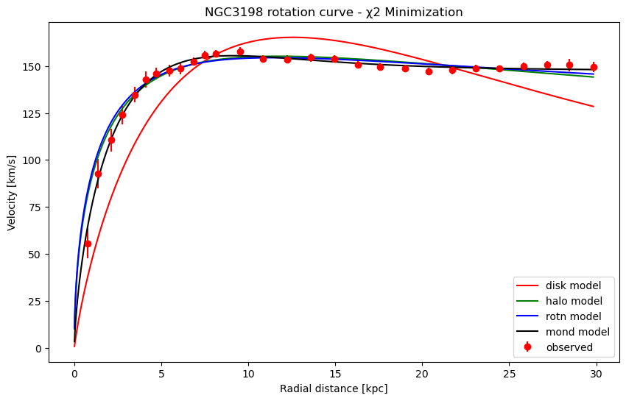
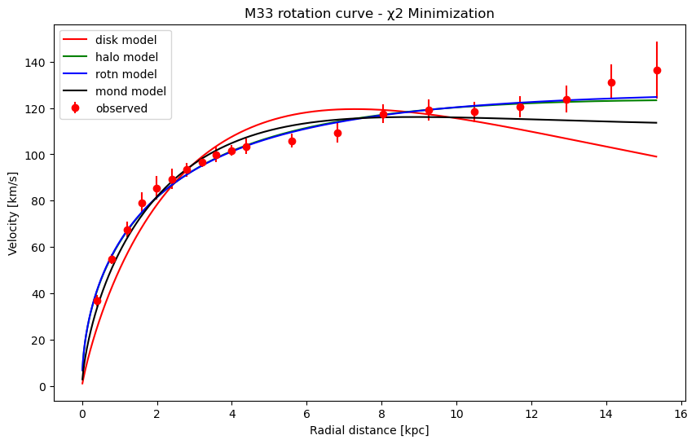
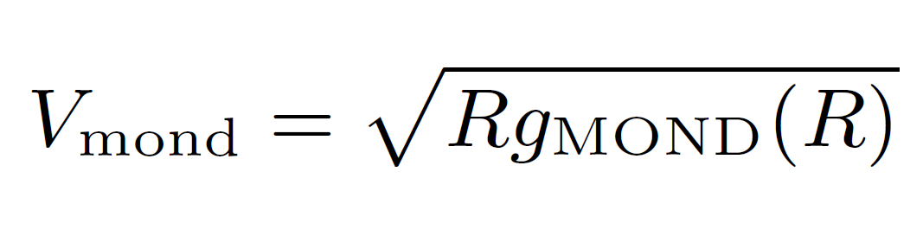
Ind. Project: Dark Matter - Jorge Casas
The overall objective of the code is to fit different models to observed galactic rotation curves, compare their statistical performance using BIC and AIC values, and determine the minimum data required to distinguish between the models.
We first examine two models: the disk, halo, disk+halo model and the MOND disk model, and evaluated the performance of these models in describing the observed data and to determine the most suitable model for each individual galaxy. The MOND model was the preferred model choice, and the Eq. is copied above.
We looked at the consistency of estimates for a critical acceleration parameter, acrit. We also looked into synthesizing a hypothetical dataset with smaller errors to differentiate between the Cold Dark Matter (CDM) and Modified Newtonian Dynamics (MOND) models with a 5σ level of confidence.

Slide 2
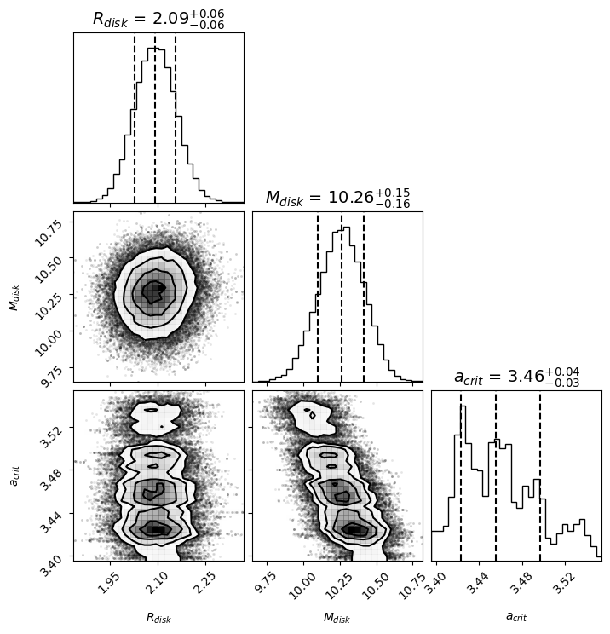
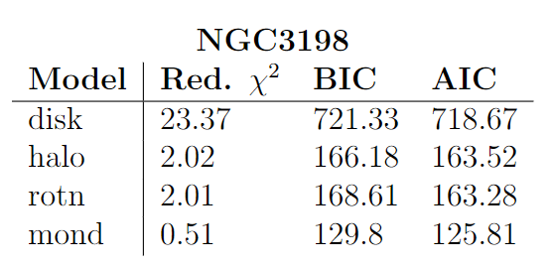
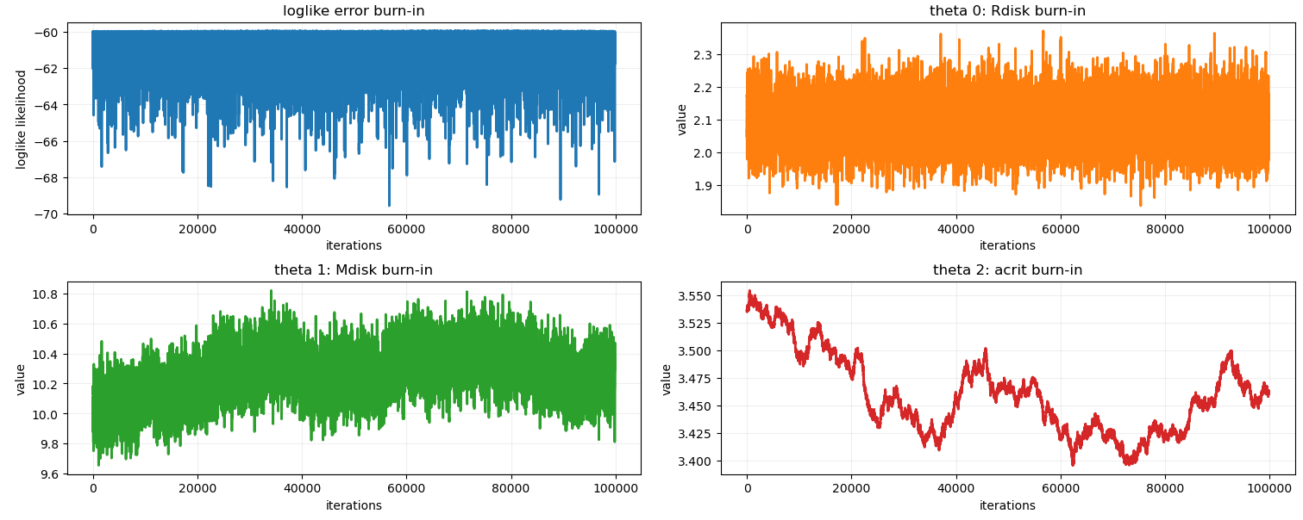
Below are the resulting Red. χ2, BIC, and AIC values for each of the galaxy rotation curves calculated from the χ2 minimization.
NGC3198
best fitting parameters
acrit: 2.82
An MCMC algorithm was also used to independently validate the best fitting parameters for the MOND models. Pictured above is one sample of the posteriors for each of the parameters Rdisk, Mdisk, and acrit for the NGC3198 galaxy rotation curve.
Note: acrit did not converge during MCMC attempts

Slide 3
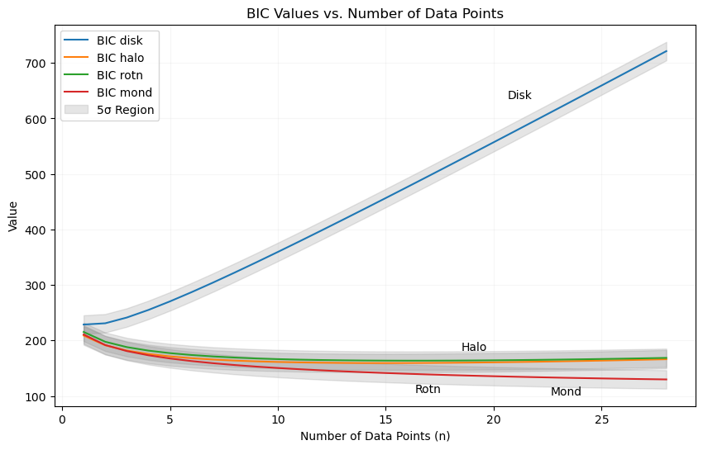
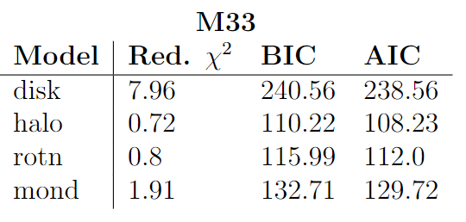
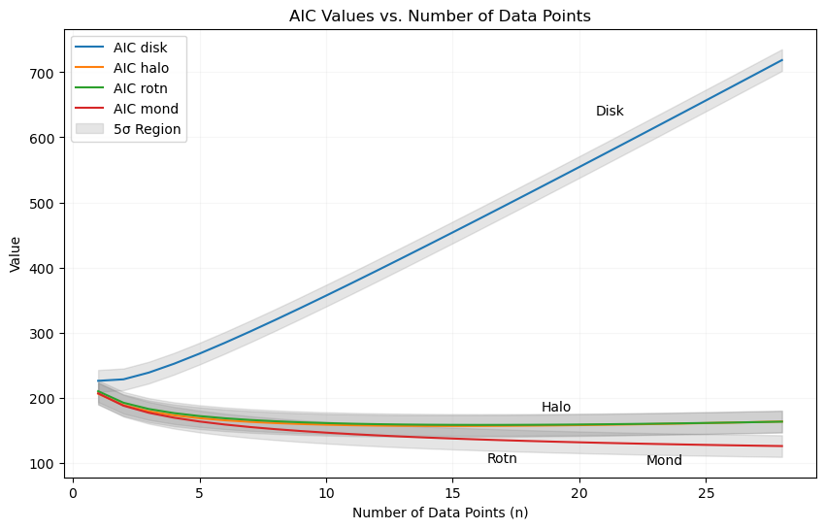
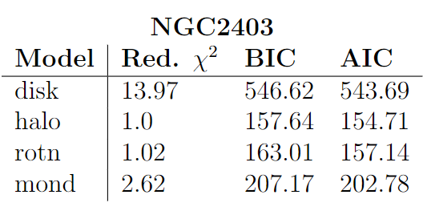




By progressively reducing the errors in a hypothetical data set calculated from the original dataset. We can repeat the model fitting process and evaluate the BIC and AIC values for each model. The divergence between BIC and AIC values are plotted to the right against an increasing n-size of data points.
The resulting minimum n-size data points is ~12 points before the BIC and AIC values start to favor the hypothetical value at a 5σ error region plotted in gray for the NGC3198 rotation curve.
acrit: 10.0
acrit: 10.0
Interestingly, halo models are preferred in the M33 and NGC2403 case, whereas MOND models are highly preferred by the NGC3198 case. The χ2 minimization also fails to calculate a varied acrit value for these galaxies.

